Slide 1


[Sales Data]

Slide 2


Today's agenda
Project recap
Problem
Process
Insights
Screen Shots
Source Code

Slide 3

work with a Sales database containing a total of 5 tables related to customer’s information, product details, PIN code details, delivery person details and order details.
To uncover insights from sales data.
System used: MYSQL Workbench
Project Recap

Slide 4

Problem
uncover the dataset to know which city has the most orders and increase the delivery-person there.
track the discount percentage to make sure every product stay on the profitable side.
know which product from the two brands has the highest total sales and less returned orders.
*The project has 3 parts to be completed and answering 19 questions through SQL queries, starting from Basic questions (using select, from statement), intermediate using Join clause to get the data from different tables at the same time and Advances questions which I used the lengthiest statement and subqueries.

Slide 5
Process
1
Data Understanding
2
Data Cleaning
3
Data Modeling
4
Data Analysis
5
Uncover Insights

Slide 6

Insights
Laptop
Absolute_profit: 4028860
percentage_profit: 58.175
mouse
Absolute_profit: 970516
percentage_profit: 97.573
Pendrive
Absolute_profit: 614461
percentage_profit: 114.074
Customers who don’t have DOB info : 2
Products MRP:
HP 241H: 80000 / Dell AX420: 75000
Pincode with average amount paid with more than 150,000
Taking only ‘buy’ order : 110001

Slide 7
Screen Shots

Slide 8
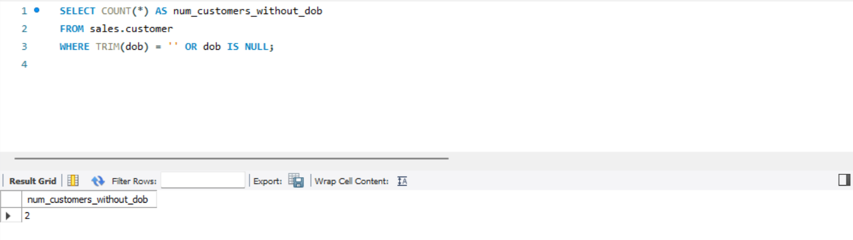

Slide 9
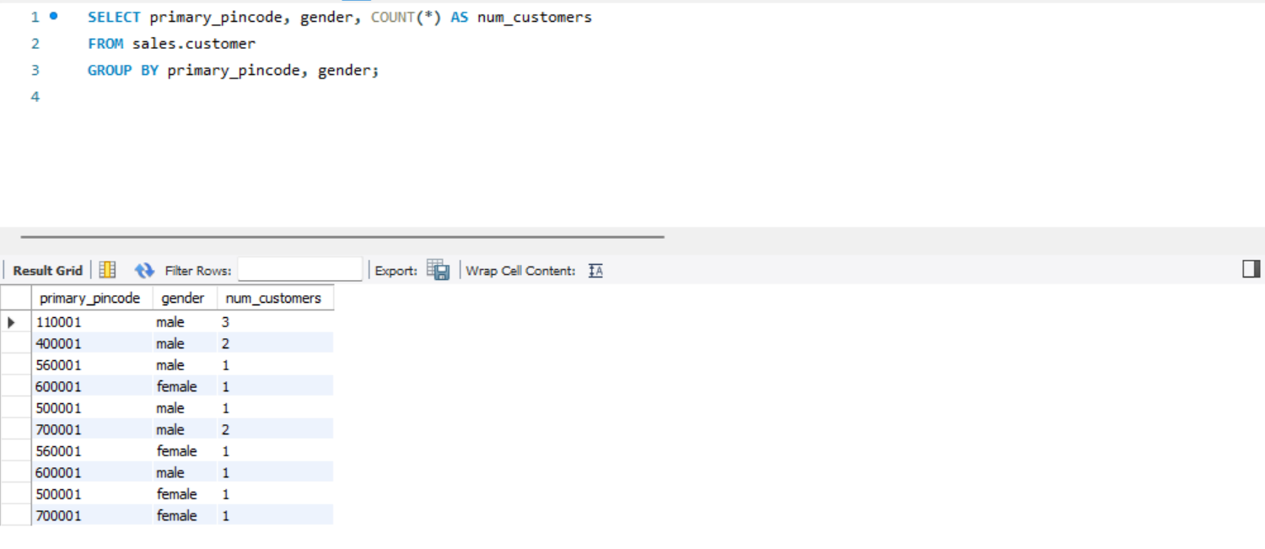

Slide 10
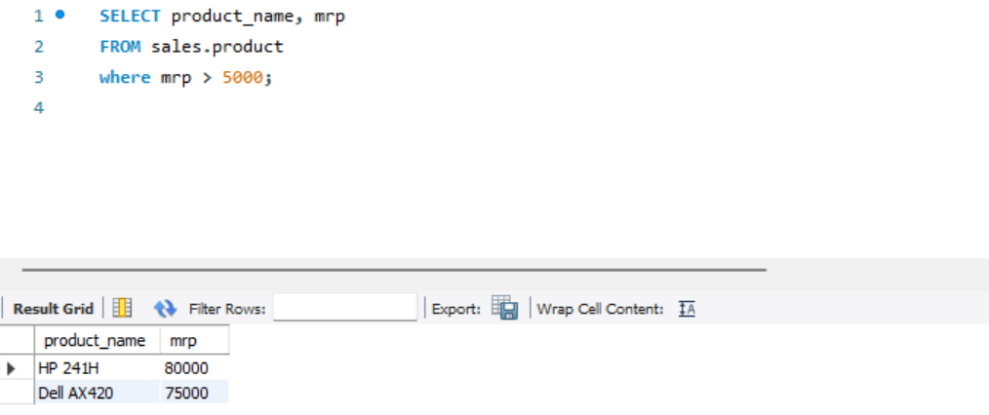

Slide 11
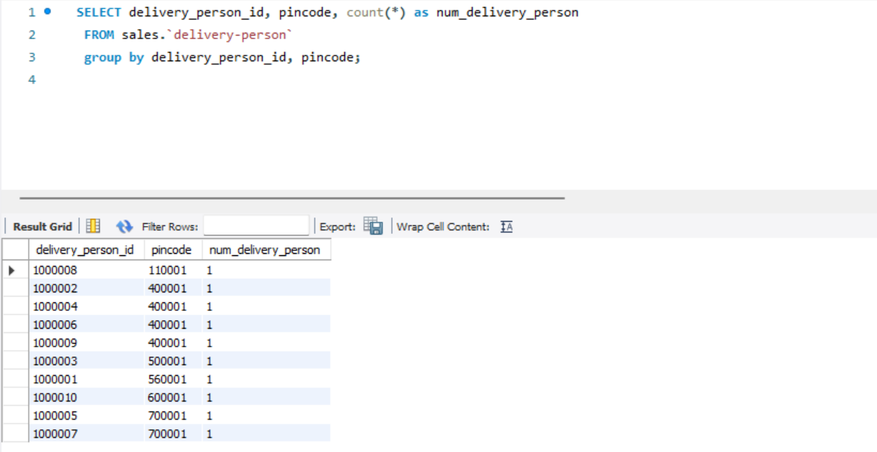

Slide 12
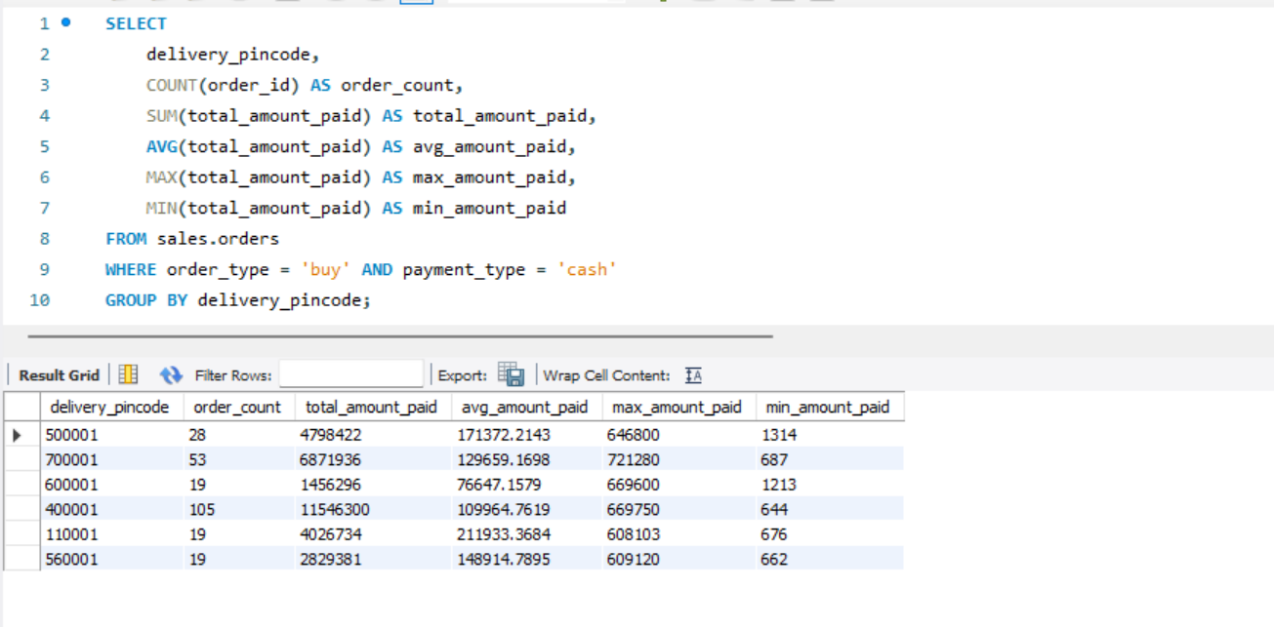

Slide 13
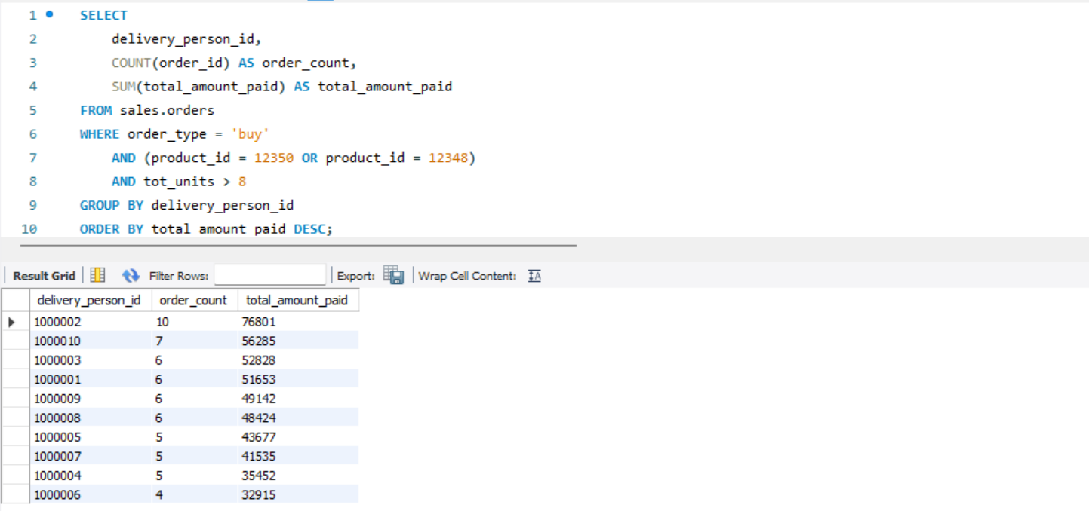

Slide 14
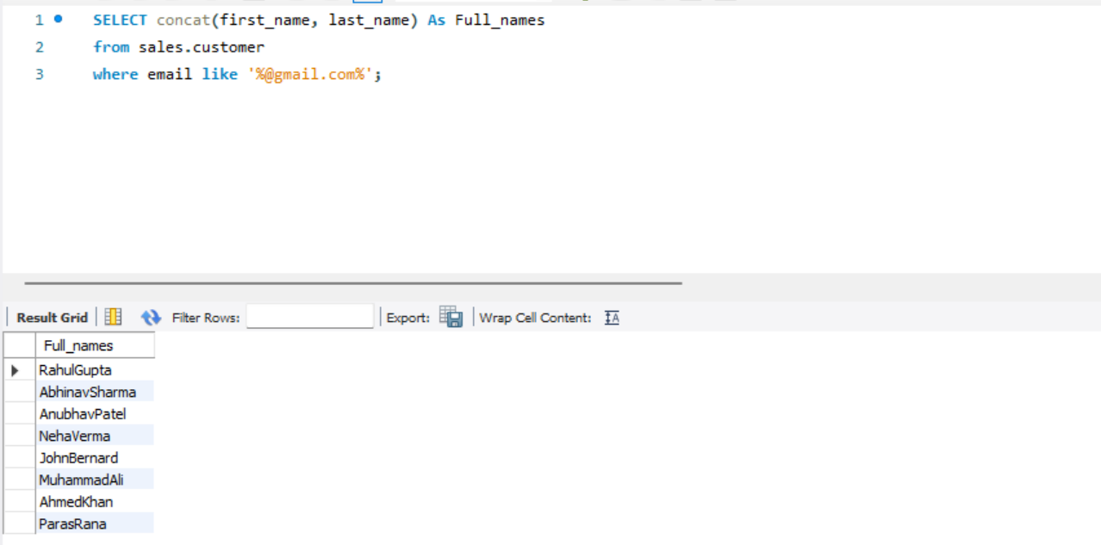

Slide 15
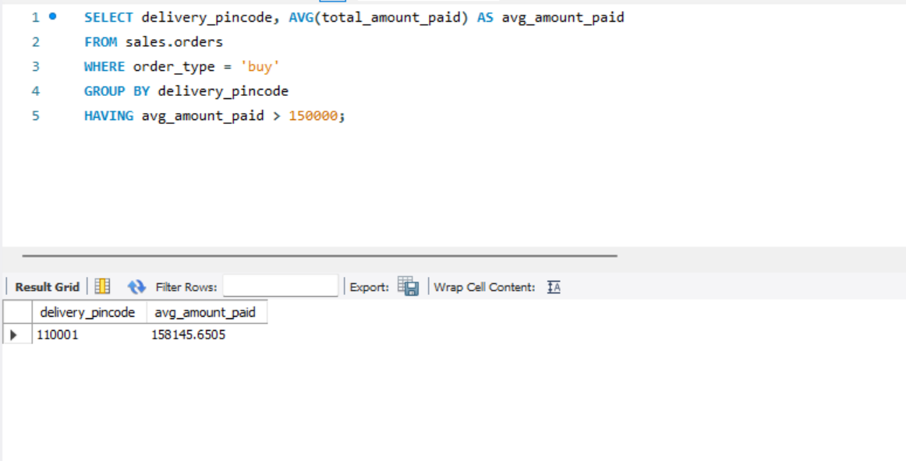

Slide 16
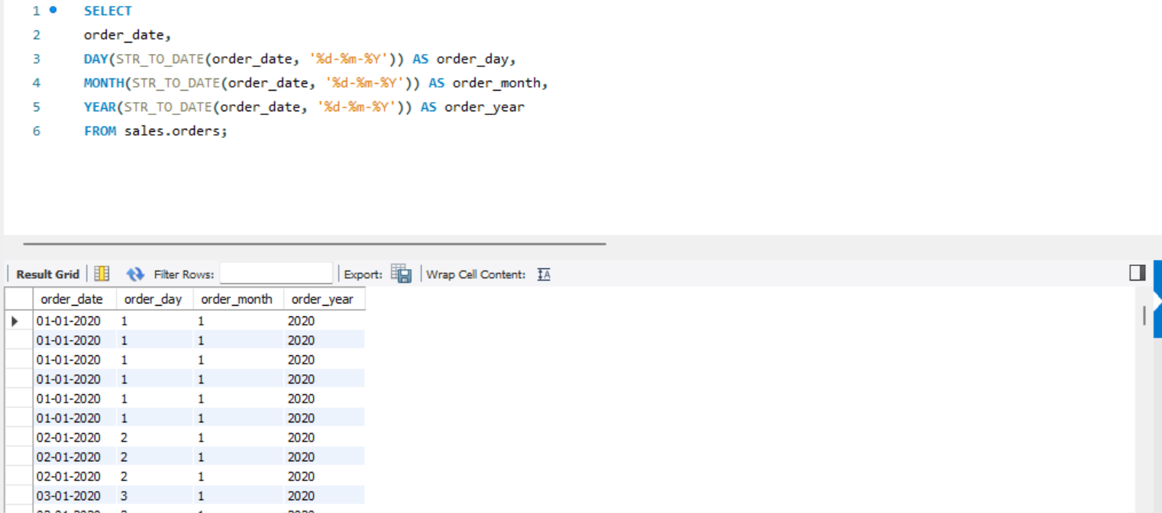

Slide 17
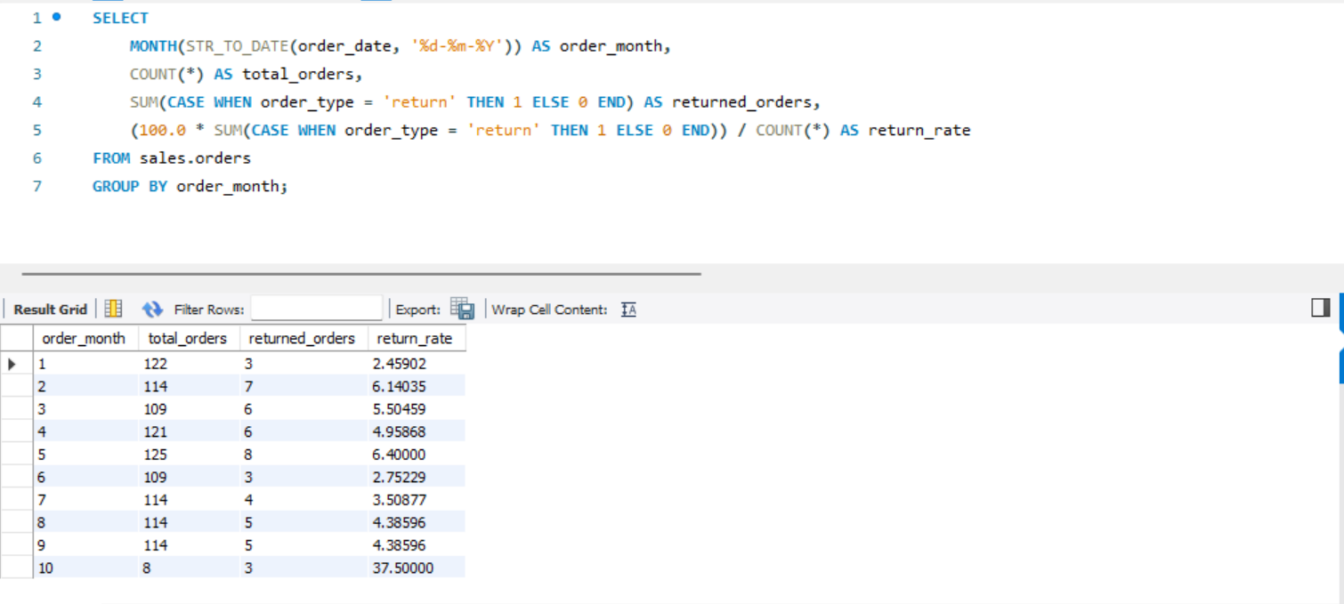

Slide 18
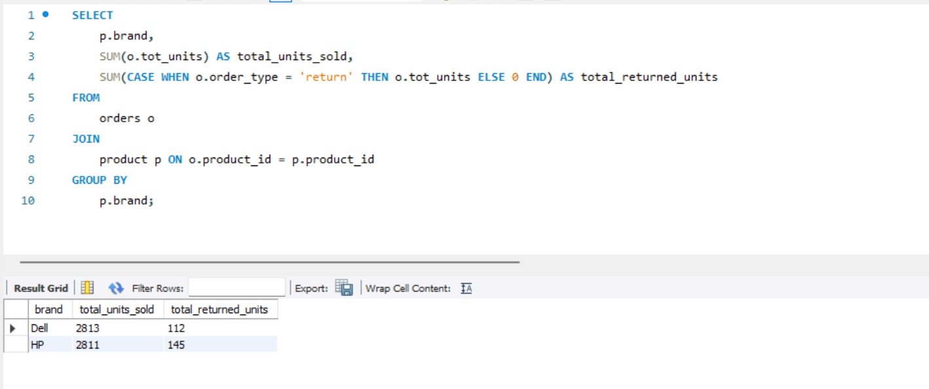

Slide 19
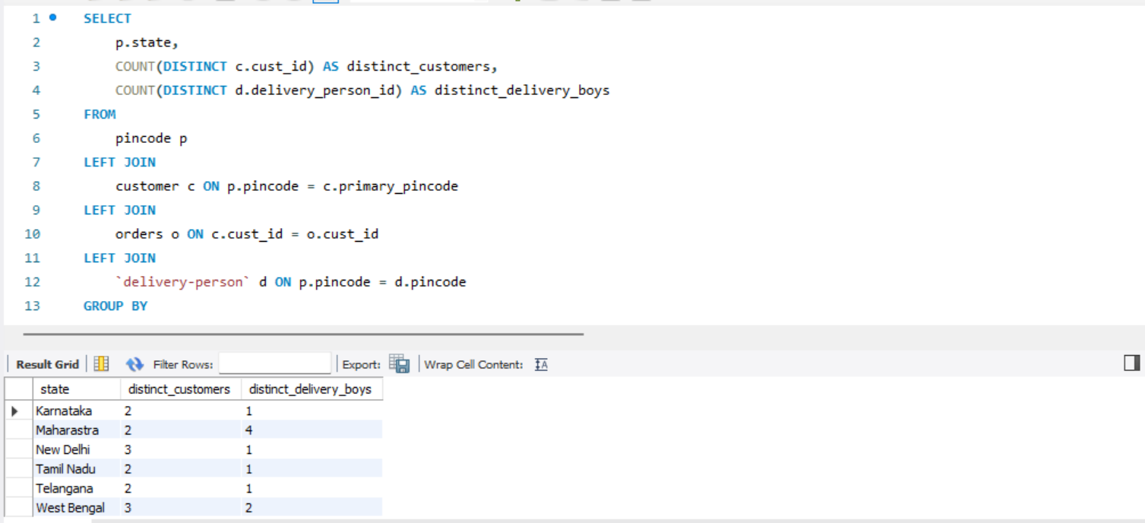

Slide 20
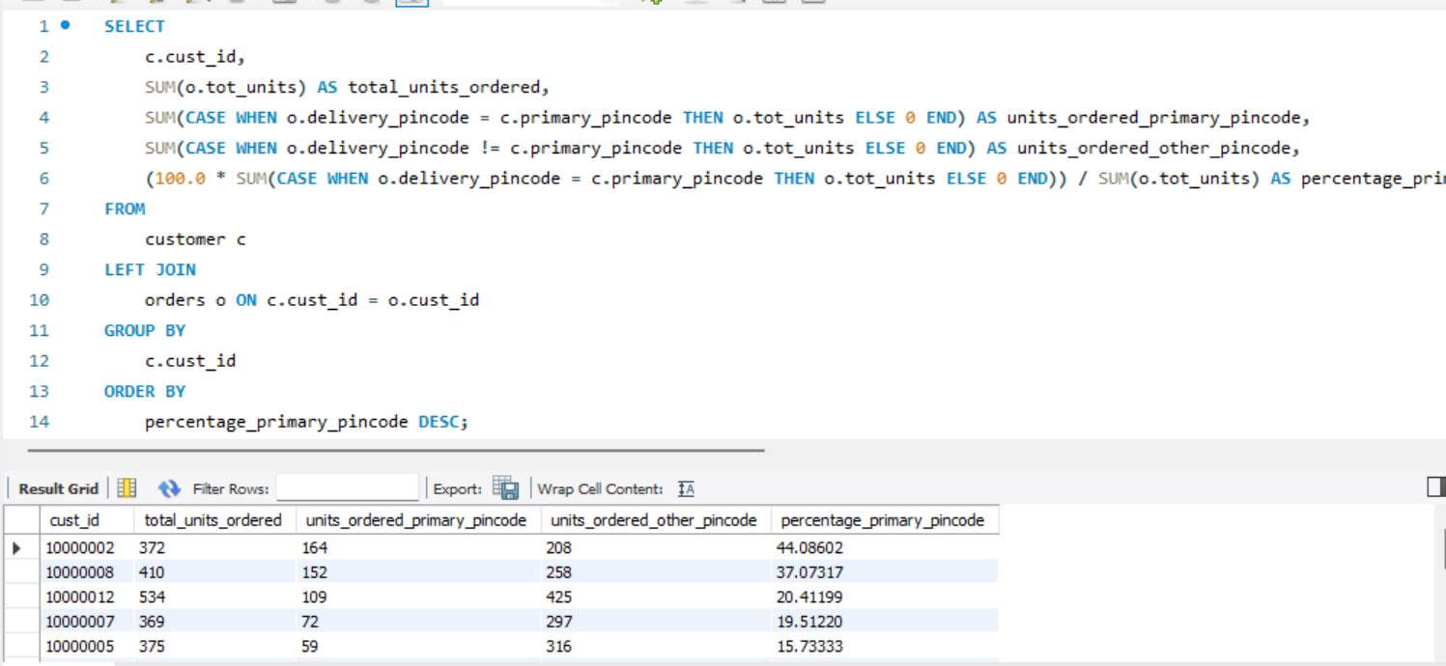

Slide 21
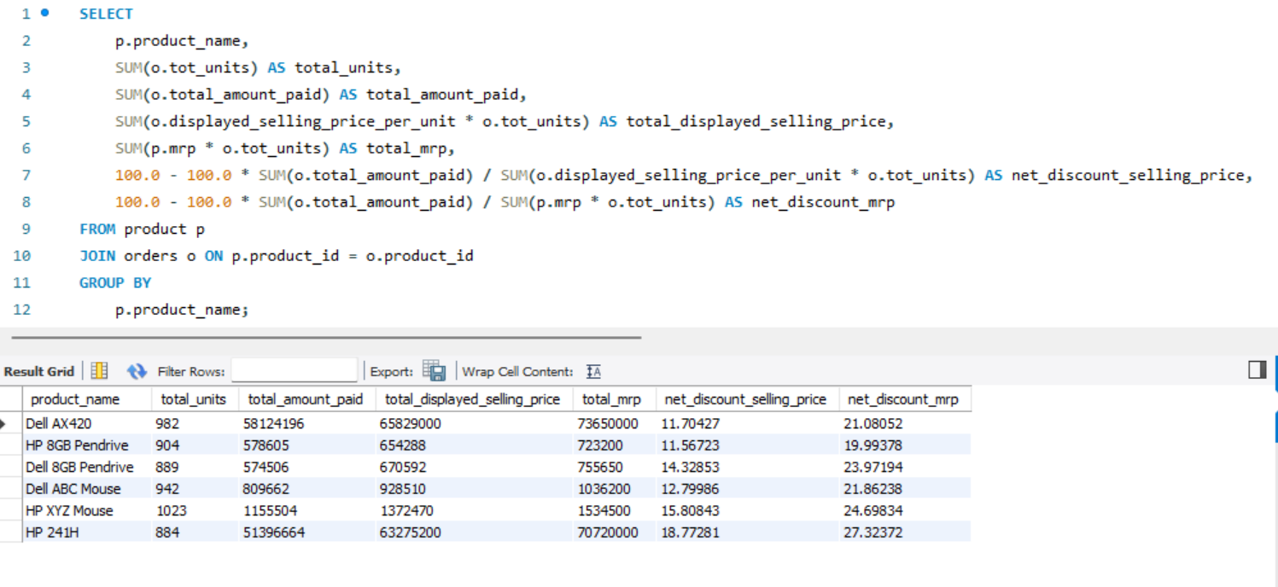

Slide 22
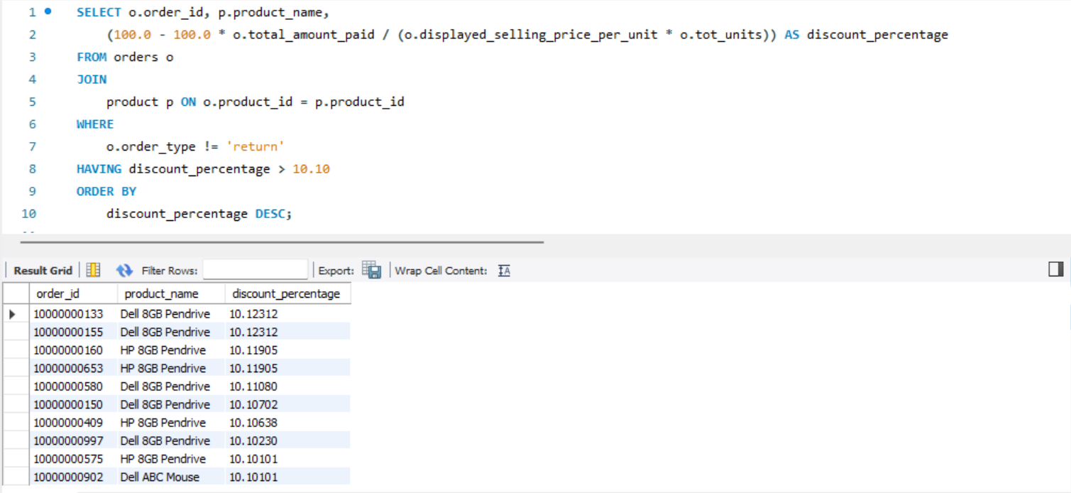

Slide 23
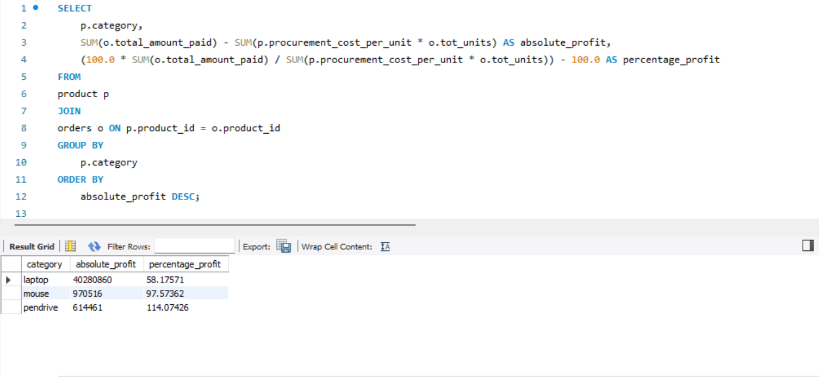

Slide 24
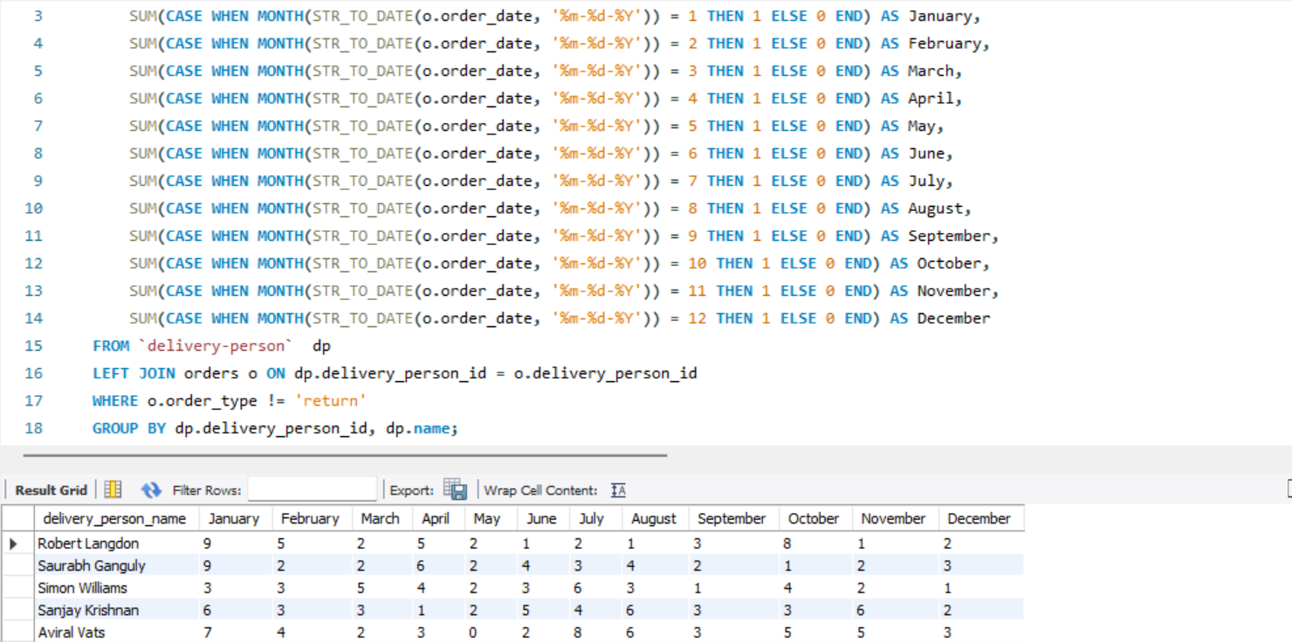

Slide 25
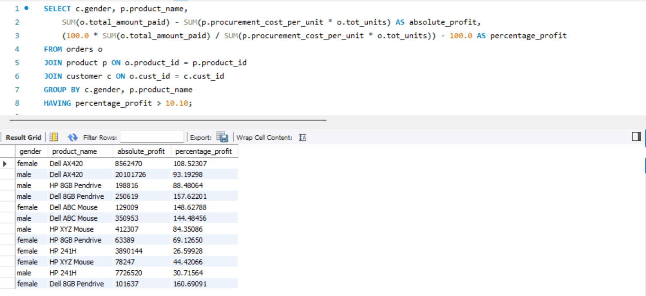

Slide 26
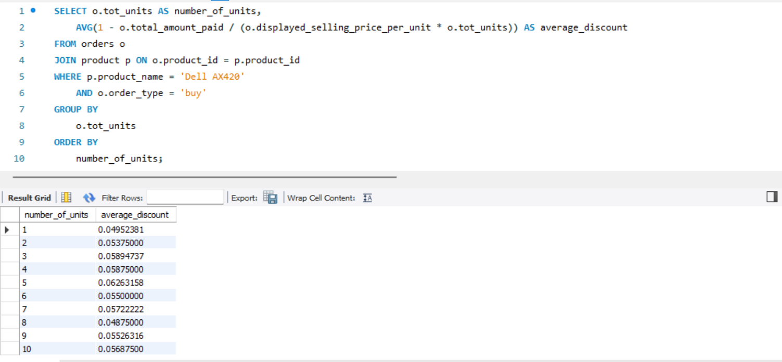

Slide 27
Source Code

Slide 28
1- SELECT COUNT(*) AS num_customers_without_dob
FROM sales.customer
WHERE TRIM(dob) = '' OR dob IS NULL;
2-SELECT primary_pincode, gender, COUNT(*) AS num_customers
FROM sales.customer
GROUP BY primary_pincode, gender;
3- SELECT product_name, mrp
FROM sales.product
where mrp > 5000;
4- SELECT delivery_person_id, pincode, count(*) as num_delivery_person
FROM sales.`delivery-person` group by delivery_person_id, pincode;
5- SELECT
delivery_pincode,
COUNT(order_id) AS order_count,
SUM(total_amount_paid) AS total_amount_paid,
AVG(total_amount_paid) AS avg_amount_paid,
MAX(total_amount_paid) AS max_amount_paid,
MIN(total_amount_paid) AS min_amount_paid
FROM sales.orders
WHERE order_type = 'buy' AND payment_type = 'cash'
GROUP BY delivery_pincode;

Slide 29
6- SELECT
delivery_person_id,
COUNT(order_id) AS order_count,
SUM(total_amount_paid) AS total_amount_paid
FROM sales.orders
WHERE order_type = 'buy'
AND (product_id = 12350 OR product_id = 12348)
AND tot_units > 8
GROUP BY delivery_person_id
ORDER BY total_amount_paid DESC;
7- SELECT concat(first_name,' ', last_name) As Full_names
from sales.customer
where email like '%@gmail.com%';
8- SELECT delivery_pincode, AVG(total_amount_paid) AS avg_amount_paid
FROM sales.orders
WHERE order_type = 'buy'
GROUP BY delivery_pincode
HAVING avg_amount_paid > 150000;
9- SELECT order_date,
DAY(STR_TO_DATE(order_date, '%d-%m-%Y')) AS order_day,
MONTH(STR_TO_DATE(order_date, '%d-%m-%Y')) AS order_month,
YEAR(STR_TO_DATE(order_date, '%d-%m-%Y')) AS order_year
FROM sales.orders;

Slide 30
10- SELECT
MONTH(STR_TO_DATE(order_date, '%d-%m-%Y')) AS order_month,
COUNT(*) AS total_orders,
SUM(CASE WHEN order_type = 'return' THEN 1 ELSE 0 END) AS returned_orders,
(100.0 * SUM(CASE WHEN order_type = 'return' THEN 1 ELSE 0 END)) / COUNT(*) AS return_rate
FROM sales.orders
GROUP BY order_month;
*** at first I run a query on sales schema to rename the empty column name on the product table to product_id
(USE sales;
ALTER TABLE product
CHANGE COLUMN MyUnknownColumn product_id INT;)
11- SELECT
p.brand,
SUM(o.tot_units) AS total_units_sold,
SUM(CASE WHEN o.order_type = 'return' THEN o.tot_units ELSE 0 END) AS total_returned_units
FROM
orders o
JOIN
product p ON o.product_id = p.product_id
GROUP BY
p.brand;

Slide 31
12- SELECT p.state,
COUNT(DISTINCT c.cust_id) AS distinct_customers,
COUNT(DISTINCT d.delivery_person_id) AS distinct_delivery_boys
FROM pincode p
LEFT JOIN
customer c ON p.pincode = c.primary_pincode
LEFT JOIN
orders o ON c.cust_id = o.cust_id
LEFT JOIN
`delivery-person` d ON p.pincode = d.pincode
GROUP BY
p.state;
13- SELECT c.cust_id,
SUM(o.tot_units) AS total_units_ordered,
SUM(CASE WHEN o.delivery_pincode = c.primary_pincode THEN o.tot_units ELSE 0 END) AS units_ordered_primary_pincode,
SUM(CASE WHEN o.delivery_pincode != c.primary_pincode THEN o.tot_units ELSE 0 END) AS units_ordered_other_pincode,
(100.0 * SUM(CASE WHEN o.delivery_pincode = c.primary_pincode THEN o.tot_units ELSE 0 END)) / SUM(o.tot_units) AS percentage_primary_pincode
FROM
customer c
LEFT JOIN
orders o ON c.cust_id = o.cust_id
GROUP BY
c.cust_id
ORDER BY
percentage_primary_pincode DESC;

Slide 32
14- SELECT
p.product_name,
SUM(o.tot_units) AS total_units,
SUM(o.total_amount_paid) AS total_amount_paid,
SUM(o.displayed_selling_price_per_unit * o.tot_units) AS total_displayed_selling_price,
SUM(p.mrp * o.tot_units) AS total_mrp,
100.0 - 100.0 * SUM(o.total_amount_paid) / SUM(o.displayed_selling_price_per_unit * o.tot_units) AS net_discount_selling_price,
100.0 - 100.0 * SUM(o.total_amount_paid) / SUM(p.mrp * o.tot_units) AS net_discount_mrp
FROM
product p
JOIN
orders o ON p.product_id = o.product_id
GROUP BY
p.product_name;
15- SELECT o.order_id, p.product_name,
(100.0 - 100.0 * o.total_amount_paid / (o.displayed_selling_price_per_unit * o.tot_units)) AS discount_percentage
FROM orders o
JOIN
product p ON o.product_id = p.product_id
WHERE
o.order_type != 'return'
HAVING discount_percentage > 10.10
ORDER BY
discount_percentage DESC;

Slide 33
16- SELECT p.category,
SUM(o.total_amount_paid) - SUM(p.procurement_cost_per_unit * o.tot_units) AS absolute_profit,
(100.0 * SUM(o.total_amount_paid) / SUM(p.procurement_cost_per_unit * o.tot_units)) - 100.0 AS percentage_profit
FROM
product p
JOIN
orders o ON p.product_id = o.product_id
GROUP BY
p.category
ORDER BY
absolute_profit DESC;
18- SELECT c.gender,
p.product_name,
SUM(o.total_amount_paid) - SUM(p.procurement_cost_per_unit * o.tot_units) AS absolute_profit,
(100.0 * SUM(o.total_amount_paid) / SUM(p.procurement_cost_per_unit * o.tot_units)) - 100.0 AS percentage_profit
FROM
orders o
JOIN
product p ON o.product_id = p.product_id
JOIN
customer c ON o.cust_id = c.cust_id
GROUP BY
c.gender, p.product_name
HAVING
percentage_profit > 10.10;

Slide 34
17- USE sales; SELECT
dp.name AS delivery_person_name,
SUM(CASE WHEN MONTH(STR_TO_DATE(o.order_date, '%m-%d-%Y')) = 1 THEN 1 ELSE 0 END) AS January,
SUM(CASE WHEN MONTH(STR_TO_DATE(o.order_date, '%m-%d-%Y')) = 2 THEN 1 ELSE 0 END) AS February,
SUM(CASE WHEN MONTH(STR_TO_DATE(o.order_date, '%m-%d-%Y')) = 3 THEN 1 ELSE 0 END) AS March,
SUM(CASE WHEN MONTH(STR_TO_DATE(o.order_date, '%m-%d-%Y')) = 4 THEN 1 ELSE 0 END) AS April,
SUM(CASE WHEN MONTH(STR_TO_DATE(o.order_date, '%m-%d-%Y')) = 5 THEN 1 ELSE 0 END) AS May,
SUM(CASE WHEN MONTH(STR_TO_DATE(o.order_date, '%m-%d-%Y')) = 6 THEN 1 ELSE 0 END) AS June,
SUM(CASE WHEN MONTH(STR_TO_DATE(o.order_date, '%m-%d-%Y')) = 7 THEN 1 ELSE 0 END) AS July,
SUM(CASE WHEN MONTH(STR_TO_DATE(o.order_date, '%m-%d-%Y')) = 8 THEN 1 ELSE 0 END) AS August,
SUM(CASE WHEN MONTH(STR_TO_DATE(o.order_date, '%m-%d-%Y')) = 9 THEN 1 ELSE 0 END) AS September,
SUM(CASE WHEN MONTH(STR_TO_DATE(o.order_date, '%m-%d-%Y')) = 10 THEN 1 ELSE 0 END) AS October,
SUM(CASE WHEN MONTH(STR_TO_DATE(o.order_date, '%m-%d-%Y')) = 11 THEN 1 ELSE 0 END) AS November,
SUM(CASE WHEN MONTH(STR_TO_DATE(o.order_date, '%m-%d-%Y')) = 12 THEN 1 ELSE 0 END) AS December
FROM `delivery-person` dp
LEFT JOIN orders o ON dp.delivery_person_id = o.delivery_person_id
WHERE o.order_type != 'return'
GROUP BY dp.delivery_person_id, dp.name;

Slide 35
19- SELECT
o.tot_units AS number_of_units,
AVG(1 - o.total_amount_paid / (o.displayed_selling_price_per_unit * o.tot_units)) AS average_discount
FROM
orders o
JOIN
product p ON o.product_id = p.product_id
WHERE
p.product_name = 'Dell AX420'
AND o.order_type = 'buy'
GROUP BY
o.tot_units
ORDER BY number_of_units;

Slide 36
Thank you!

